Slide 1
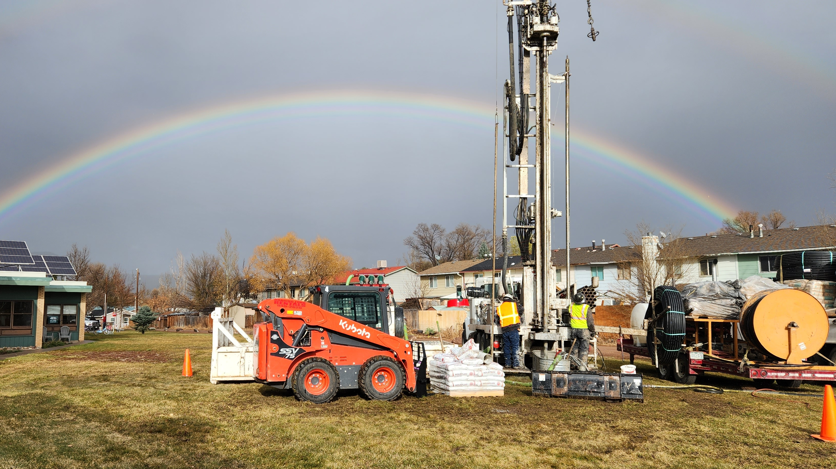
Thermal Energy Networks
The GreyEdge Group
1/7/25
Matt Garlick 801-907-5654 mgarlick@greyedgegroup.com

Slide 2
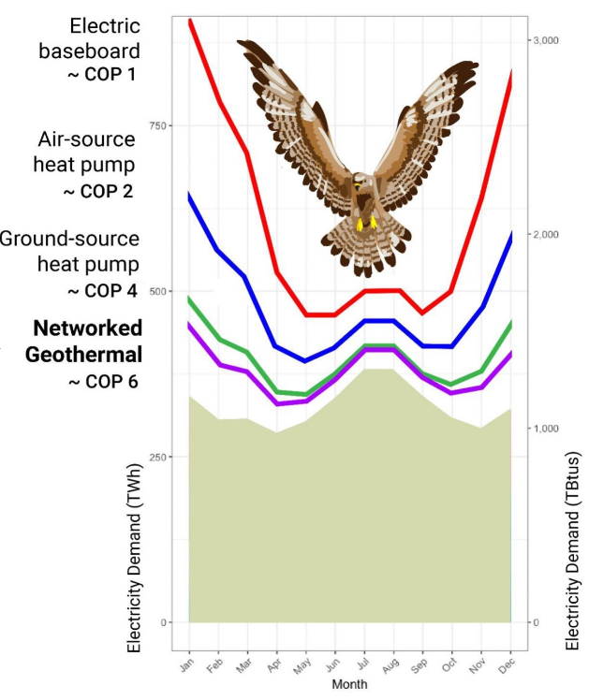

Understand the Problem
1

Slide 3
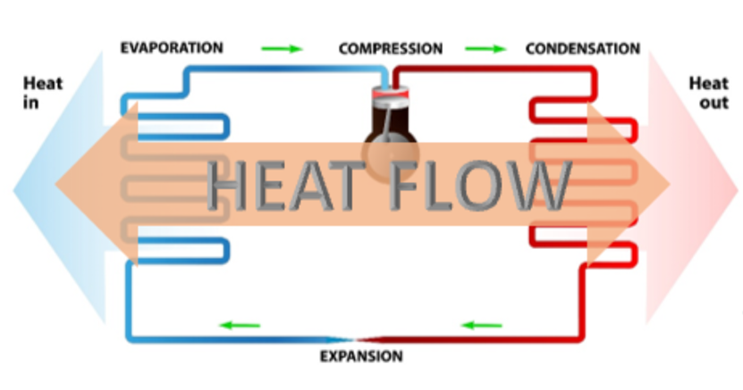
The Nature of the Tool-
Heat Pumps
2
Heat Sources:
Inside Air
Outside Air
Ground Water
Waste Water
Potable Water
Thermal Districts
Thermal Storage
Others
Heat Sinks:
Inside Air
Outside Air
Ground Water
Waste Water
Potable Water
Thermal Districts
Thermal Storage
Others
Notes:
Heat pump is an energy pump

Slide 4
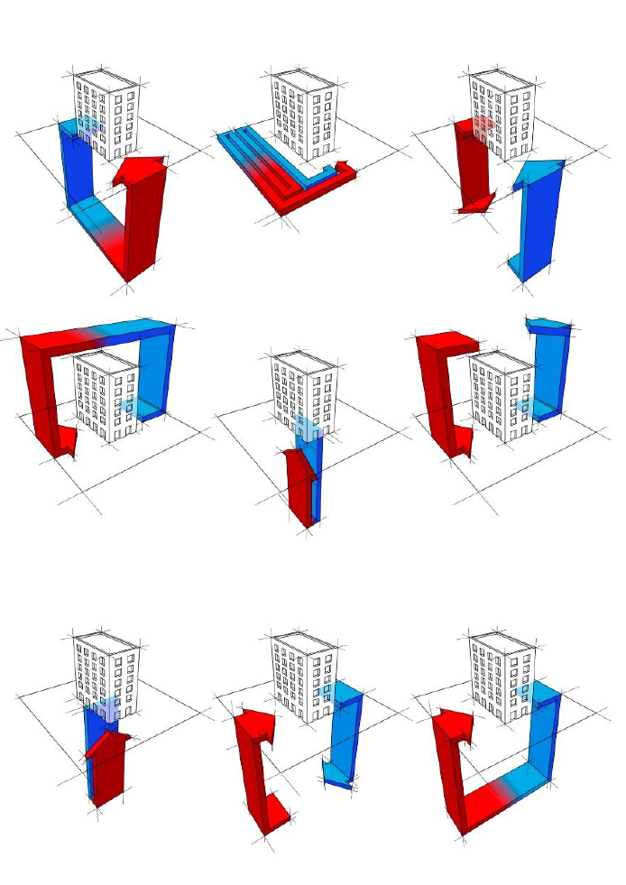
The Nature of the Tool-
Building Heat Pump Systems
3

Slide 5
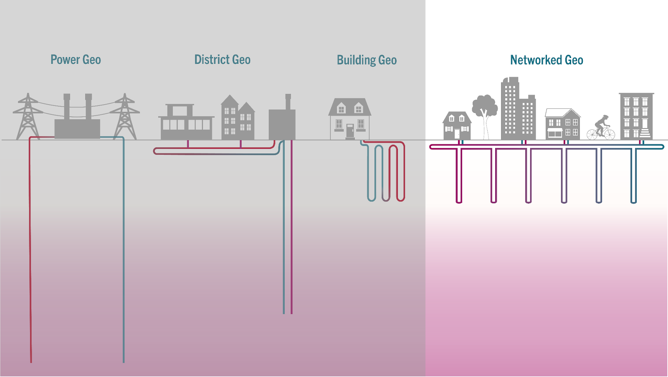
The Nature of the Tool-
Thermal Energy Networks
4
Thermal Energy Networks

Slide 6
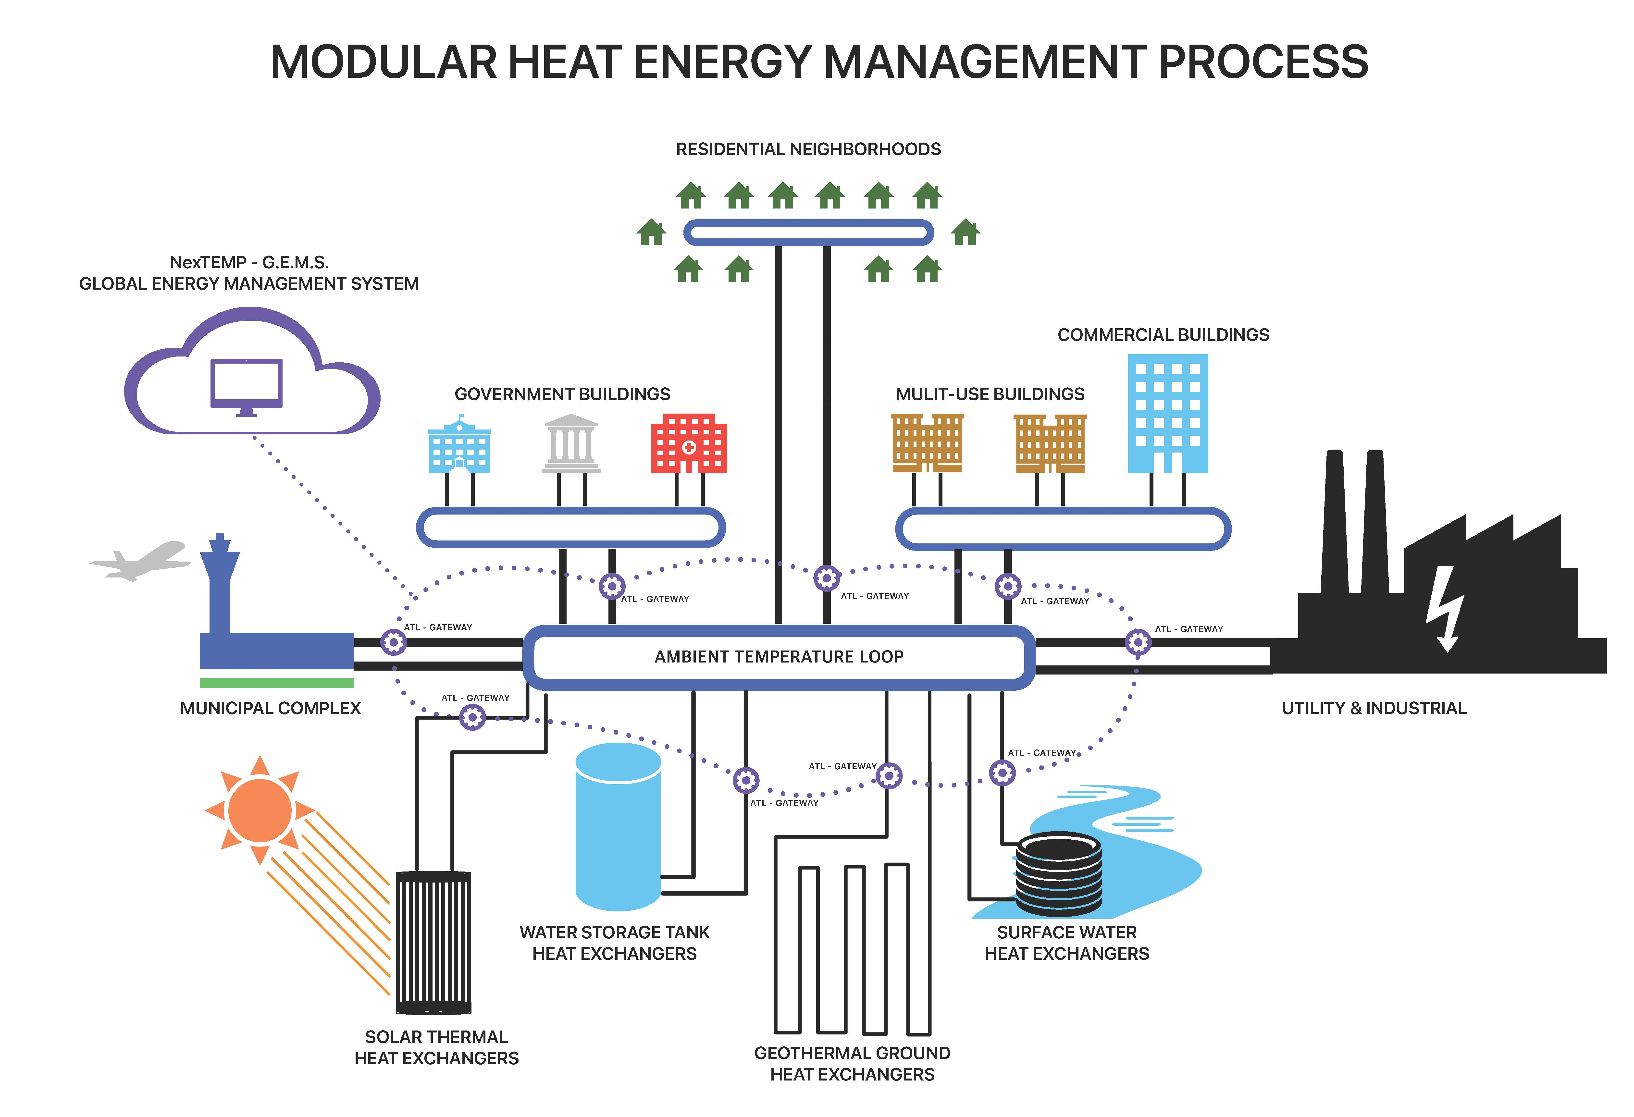
5
Ambient Temperature Loops (ATL)

Slide 7
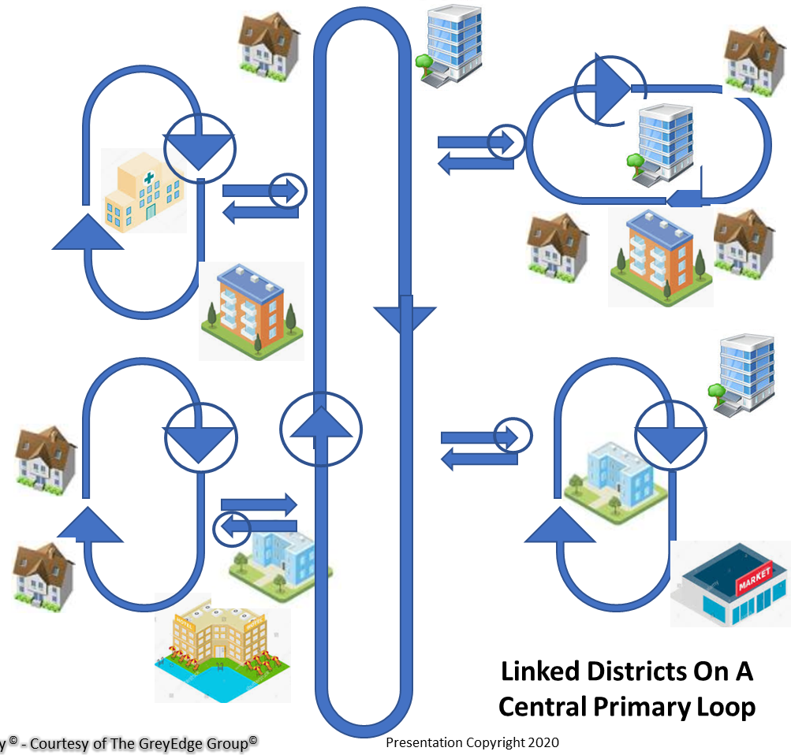
6
ATL Microgrids

Slide 8
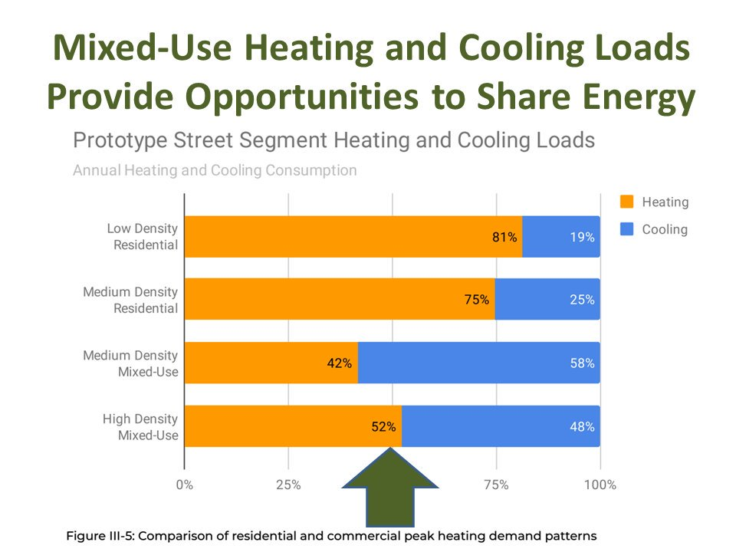
7
System Diversity

Slide 9
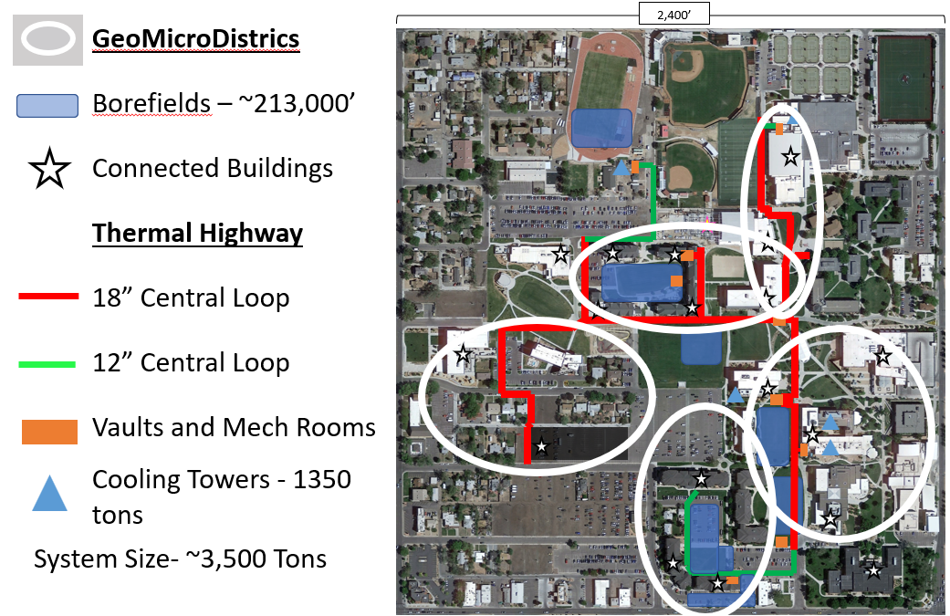
8
Case Studies- Colorado Mesa University
Notes:
Cumulative System Load (1,213,572) SF
16 Buildings
Maximum flow 4,800 GPM
Minimum flow 850 GPM
Average flow 3,200 GPM
3500 Tons Capacity
Min temp (winter) 45; max temp (summer) 95
Speak to demand limiting button

Slide 10
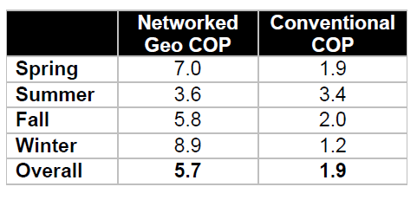
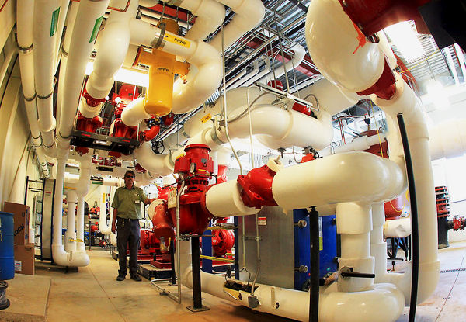
9
Case Studies- Colorado Mesa University
Without District System:
217 vertical feet of borehole per installed ton
Calculated water use: 14.5MM gallons/yr.
(3,400 tons CT)
Electric Load 784 kW
With District System:
84 vertical feet of borehole per installed ton
Estimated Water Use: 4.5MM gallons
(705 tons CT)
Electric Load: 185 kW
>$2,000,000 in annual utility savings

Slide 11
10
Ownership Models
Public Entity
Utility
3rd Party
Finance
Own
Operate

Slide 12
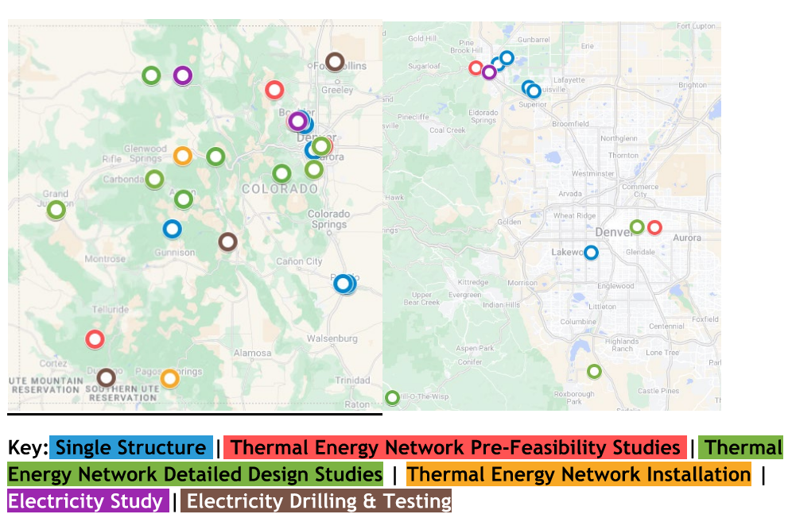
11
Current Colorado Projects

